Slide 1
LOGGING SOLUTIONS FOR WEB APPLICATIONS
Group Members:
1. Padegal Sai GiriRaj (U101115FCS121)
2. P.Revanth (U101115FCS265)
3. M.Praveen (U101115FCS126)
4. Boyina Santosh (U101115FCS140)
5. I.Lohiya (U101115FCS100)
Group Mentor : DIVYA AGGARWAL

Slide 2
OBJECTIVES
We will be building comprehensive plugin for the web applications to generate the log files to :
View full application error details.
Logging setup should be easy especially for system administrators.
Security logging , it should (i)detect attacks (ii)unauthorized URL access (iii) detect errors(loss of availability).
Notes:
What is log file?
A log file records events and actions that take place during the runtime of a service or application.

Slide 3
BACKGROUND
Logging , Why?
Logging is the act of keeping a log .
Logging is easier and faster than debugging.
What is Log file?
Log file records the events and actions that takes place during the runtime of service or application.
Notes:
So why are log files so important?
Log files provide us with a precise view of the behavior of a server as well as critical information about when, how and “by whom” a server is being accessed.This kind of information can help us monitor the performance, troubleshoot and debug applications, as well as help forensic investigators unfold the chain of events that may have led to a malicious activity

Slide 4
Advantages of having log files:
Log files provide us with a precise view of the behaviour of a server as well as critical information about when , how and “by whom” a server is being accessed.
This kind of information can help us monitor the performance,troubleshoot and debug applications.
Logs can be referenced later as the data is stored.
Notes:
So why are log files so important?
Log files provide us with a precise view of the behavior of a server as well as critical information about when, how and “by whom” a server is being accessed.This kind of information can help us monitor the performance, troubleshoot and debug applications, as well as help forensic investigators unfold the chain of events that may have led to a malicious activity

Slide 5
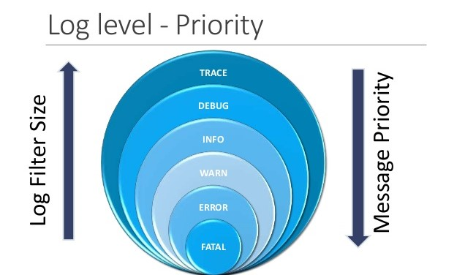
Severity Level
Of logging message
Classification of log messages.
Lower level indicates higher level message

Slide 6
WORK DONE SO FAR
We have created a web application (health care) which consists of many features for online consultation of doctors,health calculators(BMI,calorie)and medication.
So, that we will be generating log files for the web application.
Basic knowledge of Log4j.

Slide 7
TECHNOLOGIES USED
Java
Html
Css
JavaScript
MySql
Log4J(library of java for logging)

Slide 8
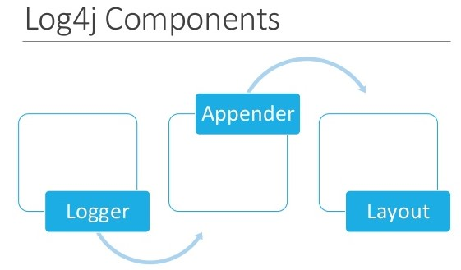

Slide 9
WORK PLAN FOR NEXT ONE MONTH
We will be creating plugin to monitor the web application
Further, we will be creating log files for the logging events.
Application error details.

Slide 10
References
1.https://en.wikipedia.org/wiki/Log_file
2.https://blog.sucuri.net/2010/03/the-importance-of-logging-for-web-applications-security-talk.html
3.https://www.tutorialspoint.com/log4j/log4j_logging_methods.htm
4.http://logging.apache.org/log4j/1.2/index.html
5.https://www.slideshare.net/kunal.dabir/log4j-logging-mechanism

Slide 11
Any Questions ?

Slide 12
THANK YOU

